Slide 1


Franz Monzales
07/26/2024

Slide 2

Outline
Executive Summary
Introduction
Methodology
Results
Conclusion
Appendix

Slide 3
Executive Summary
Summary of methodologies
Data Collection
Utilized the SpaceX API to gather comprehensive data on all SpaceX flights..
Performing a Web Scraping to collect Falcon 9 historical launch from a Wikipedia page Titled “List of Falcon 9 and Falcon Heavy launches”
Collected detailed information on launch dates, rocket types, payloads, mission outcomes, and more.
Data Wrangling
Perform Data Cleaning for finding and removing duplicated and some irrelevant data points
Determine Training Labels convert those outcomes into Training Labels with `1` means the booster successfully landed `0` means it was unsuccessful

Slide 4
Executive Summary
Summary of methodologies
Exploratory Data Analysis (EDA) with SQL
Data Retrieval using Data Query Language (DQL) SELECT Statement to extract relevant data from the Database
Analyze Columns like Launch_Site, Payload, PAYLOAD_MASS__KG_, Orbit Then Mission and Landing Outcome
Employed Subqueries for complex calculation and analysis for further insights
Data Visualization
By using Python as Programing Language for creating Data Visualization needed
Import Libraries needed like Pandas, Matplotlib and Seaborn
Visualize the Relationship for some columns like between Flight Number and Launch Site or Payload and Launch Site using Scatter Point Chart

Slide 5
Executive Summary
Summary of methodologies
Interactive Visual Analytics
Using Folium Library in Python as Map Library to determine all launch sites on a map
Mark the success/failed launches for each site on the map
Calculate the distance between a launch site to its important proximities
Predictive Analysis
Determine the Training Label Dataset created from Data Wrangling to Standardize the data
Create a Column for the classes using for training data and test data
Find best Hyperparameter for SYM, Classification Tree and Logistic Regression

Slide 6
Introduction
Project background and context
Space X advertises Falcon 9 rocket launches on its website with a cost of 62 million dollars; other providers cost upward of 165 million dollars each, much of the savings is because Space X can reuse the first stage. Therefore if we can determine if the first stage will land, we can determine the cost of a launch. This information can be used if an alternate company wants to bid against space X for a rocket launch.
Problems you want to find answers
To predict if the first stage will land given the data from the preceding labs.
Determine the best method for Machine Learning use in predicting the outcome of Space X rockets

Slide 7

Section 1

Slide 8
Methodology
Executive Summary
Data collection methodology:
Combines detailed launch metrics from the SpaceX API with historical content and additional insights obtained though web scraping of Wikipedia to create a comprehensive dataset
Perform data wrangling
The process on Data that making sure to be made ready for EDA, for Visualization and for Modeling in ML we do Data Cleaning, Handling Missing Value, Standardization and Integration

Slide 9
Methodology
Executive Summary
Perform exploratory data analysis (EDA) using visualization and SQL
By Approach in Visualization using Scatter Point for determine relationship among the Columns in the entire Database
Perform interactive visual analytics using Folium and Plotly Dashboard
By using Folium to create interactive maps to visualiza grographical data and launch location
In Plotly Dashboard, for develop interactive dashboard for real-time data analysis and visualization
Perform predictive analysis using classification models
Identification of the most accurate classification model to enhance prediction of landing success and inform decision-making by choose between valuate Logistic Regression, SVM, Decision Tree, and K-Nearest Neighbors (KNN) for predictive accuracy.

Slide 10
Data Collection
Describe how data sets were collected.
SpaceX API
Purpose: Access detailed launch data (example Mission profile, Outcomes, Payloads)
Method: By using Request library in Python
Wikipedia Web Scraping
Purpose Supplement API data with historical context and operational details.
Method: Using BeautifulSoup Library in Python to easily get the data needed

Slide 11
Data Collection – SpaceX API
Fetch Data from SpaceX API
Set GET request to static_json_url
Load JSON response into DataFrame
Select Relevant Features
Extract columns: rocket, payloads, launchpad, cores, flight_number, date_utc
Clean Data
Remove rows with multiple cores or payloads
Extract single values from lists for cores and payloads
Filter Data
Restrict dates to ≤ November 13, 2020
Structure Data
Create a dictionary with key features
Convert dictionary to DataFrame
Github URL:https://github.com/ikigamisama/IBM-Data-Science-Capstone/blob/master/Module%201%20(Data%20Gathering%20and%20Wragling)/jupyter-labs-spacex-data-collection-api.ipynb
Start
Structure Data
Fetch Data from SpaceX API
End
Select Relevant Features
Clean Data
Filter Data

Slide 12
Data Collection - Scraping
Fetch Data: Retrieve HTML content from Wikipedia using requests.
Parse HTML: Use BeautifulSoup to parse the HTML content.
Extract Column Names: Identify and extract column names from table headers.
Initialize Data Dictionary: Create and initialize a dictionary to store launch data.
Iterate Through Tables: Loop through tables to process each row.
Extract Data from Rows: Extract specific details (flight number, date, time, etc.) using defined functions.
Populate Dictionary: Append extracted data to the dictionary.
Convert to DataFrame: Convert to DataFrame
Export Data: Save the DataFrame as a CSV file (spacex_web_scraped.csv).
Github URL:https://github.com/ikigamisama/IBM-Data-Science-Capstone/blob/master/Module%201%20(Data%20Gathering%20and%20Wragling)/jupyter-labs-webscraping.ipynb
Start
Extract Data from Rows
Fetch Data
Populate Dictionary
Extract Column Names
Convert to DataFrame
Initialize Data Dictionary
Export Data
Iterate Through Tables
End

Slide 13
Data Wrangling
Load Data: Load dataset from a CSV file into a Pandas DataFrame.
Initial Exploration: Display the first 10 rows of the dataset.
Missing Values Analysis: Calculate the percentage of missing values for each column.
Categorical Value Analysis: Analyze the distribution of values in LaunchSite and Orbit columns.
Landing Outcomes Classification: Classify landing outcomes into good (1) and bad (0).
Create Class Column: Add a binary Class column to the DataFrame.
Class Distribution Analysis: Review the distribution and mean of the Class column.
Save Processed Data: Export the cleaned and processed DataFrame to a new CSV file
Github URL:https://github.com/ikigamisama/IBM-Data-Science-Capstone/blob/master/Module%201%20(Data%20Gathering%20and%20Wragling)/labs-jupyter-spacex-Data%20wrangling.ipynb
Start
Landing Outcomes Classification
Load Data
Create Class Column
Initial Exploration
Class Distribution Analysis
Missing Values Analysis
Save Processed Data
Categorical Value Analysis
End

Slide 14
EDA with Data Visualization
Summary on what Charts were usage and why
Visualize the Relationship Between Flight Number and Launch Site Using: Catplot for analyze categorical variables and observe the relationship between flight numbers and launch sites.
Visualize the Relationship Between Payload and Launch Site Using Scatterplot To determine the relationship between payload mass and launch site locations.
Visualize the Relationship Between Success Rate of Each Orbit Type Using Bar Chart for compare the success rates across different orbit types and identify patterns or trends.
Visualize the Relationship Between Flight Number and Orbit Type using scatterplot for To observe the distribution and relationship between flight numbers and orbit types.
Visualize the Launch Success Yearly Trend using Line Chart for analyze the trend of launch successes over the years.
Feature Engineering: To convert categorical data into a format suitable for machine learning models, enhancing predictive analysis.
Github URL: https://github.com/ikigamisama/IBM-Data-Science-Capstone/blob/master/Module%202%20(Exploratory%20Data%20Analysis)/jupyter-labs-eda-dataviz.ipynb

Slide 15
EDA with SQL
Summary of SQL Queries
Display the names of the unique launch sites in the space mission.
Query: SELECT DISTINCT Launch_Site FROM SPACEXTABLE
Explanation: retrieves a unique list of all launch sites from the SPACEXTABLE. The DISTINCT keyword ensures that only distinct (unique) launch sites are returned, removing any duplicates.
Display 5 records where launch sites begin with the string ‘CCA’
Query: SELECT * FROM SPACEXTABLE WHERE Launch_Site Like 'CCA%' LIMIT 5
Explanation: Retrieve all columns from SPACEXTABLE where the Launch_Site starts with 'CCA'. The LIKE 'CCA%' clause filters the results, and LIMIT 5 restricts the output to the first 5 matching records.
Display the total payload mass carried by boosters launched by NASA (CRS)
Query: SELECT SUM(PAYLOAD_MASS__KG_) as Total_payload_mass_kg FROM SPACEXTABLE WHERE customer = 'NASA (CRS)'
Explanation: Calculates the total payload mass in kilograms for all launches where the customer is 'NASA (CRS)'. The SUM(PAYLOAD_MASS__KG_) function adds up the payload masses, and the result is labeled as Total_payload_mass_kg..

Slide 16
EDA with SQL
Display average payload mass carried by booster version F9 v1.1.
Query: SELECT AVG(PAYLOAD_MASS__KG_) as AVG_PAYLOAD_MASS_KG FROM SPACEXTABLE WHERE Booster_Version = 'F9 v1.1'
Explanation: Calculates the average payload mass in kilograms for all launches that used the 'F9 v1.1' booster version. The AVG(PAYLOAD_MASS__KG_) function computes the average, and the result is labeled as AVG_PAYLOAD_MASS_KG..
List the date when the first successful landing outcome in ground pad was acheived.
Query: SELECT * FROM SPACEXTABLE ORDER BY Date asc limit 1
Explanation:. Retrieves the earliest launch record from SPACEXTABLE. The ORDER BY Date ASC clause sorts the records by date in ascending order, and LIMIT 1 ensures only the first (earliest) record is returned.
List the names of the boosters which have success in drone ship and have payload mass greater than 4000 but less than 6000.
Query: SELECT * FROM SPACEXTABLE WHERE Landing_Outcome = 'Success (drone ship)' AND PAYLOAD_MASS__KG_ >= 4000 AND PAYLOAD_MASS__KG_ < 6000
Explanation: Retrieve all columns from SPACEXTABLE where the landing outcome was a successful drone ship landing and the payload mass is between 4000 and 5999 kilograms (inclusive of 4000 but exclusive of 6000).

Slide 17
EDA with SQL
List the total number of successful and failure mission outcomes.
Query: SELECT Mission_Outcome, count(Mission_Outcome) FROM SPACEXTABLE Group By Mission_Outcome
Explanation: Counts the number of occurrences of each mission outcome in SPACEXTABLE. The GROUP BY Mission_Outcome clause groups the records by the Mission_Outcome field, and the COUNT(Mission_Outcome) function provides the count for each group..
List the names of the booster_versions which have carried the maximum payload mass. Use a subquery
Query: SELECT * FROM (SELECT Booster_Version, max(PAYLOAD_MASS__KG_) FROM SPACEXTABLE)
Explanation :Retrieve all columns from the result of a subquery that finds the maximum payload mass for each booster version in SPACEXTABLE. The MAX(PAYLOAD_MASS__KG_) function identifies the highest payload mass.
List the records which will display the month names, failure landing_outcomes in drone ship ,booster versions, launch_site for the months in year 2015.
Query: SELECT substr(Date, 6,2) as Month, * FROM SPACEXTABLE WHERE substr(Date, 0,5) = '2015’
Explanation: Retrieve all columns from SPACEXTABLE along with the month extracted from the Date column for records from the year 2015. The SUBSTR(Date, 6, 2) function extracts the month part of the date, and SUBSTR(Date, 1, 4) = '2015' filters the results to include only those from the year 2015

Slide 18
EDA with SQL
Rank the count of landing outcomes (such as Failure (drone ship) or Success (ground pad)) between the date 2010-06-04 and 2017-03-20, in descending order..
Query SELECT * FROM (SELECT * FROM SPACEXTABLE WHERE DATE(date) BETWEEN '2010-06-04' AND '2017-03-20') GROUP BY Landing_Outcome ORDER BY date DESC
Explanation: Retrieve all records from SPACEXTABLE where the date falls between June 4, 2010, and March 20, 2017. It then groups the results by Landing_Outcome and sorts the grouped results by date in descending order.
Github Link: https://github.com/ikigamisama/IBM-Data-Science-Capstone/blob/master/Module%202%20(Exploratory%20Data%20Analysis)/jupyter-labs-eda-sql-coursera_sqllite.ipynb

Slide 19
Build an Interactive Map with Folium
1. Data Preparation
Downloaded SpaceX launch data from a CSV file.
Filtered and grouped data to obtain launch sites with their coordinates.
2. Map Creation
Downloaded SpaceX launch data from a CSV file. Initialized the map centered on NASA Johnson Space Center.
Added a marker and circle for NASA Johnson Space Center..
3. Launch Site Visualization
Created a base map centered on the average coordinates of all SpaceX launches
Used MarkerCluster to group nearby launch events.
Added markers for each launch site, color-coded based on launch success (green for successful, red for failed).
4. Additional Features
Included MousePosition to display latitude and longitude
Calculated and displayed distances between the launch site and various points of interest (e.g., coastline, railroad, highway, city).
Added lines to the map representing these distances

Slide 20
Build an Interactive Map with Folium
5. Key Code Snippets
Data Loading and Preparation.
Map Initialization and Markers.
Distance Calculation
6. Result
An interactive map showcasing SpaceX launch sites, with added layers for distances and clusters, enhancing data visualization and spatial analysis.
Github Link: https://github.com/ikigamisama/IBM-Data-Science-Capstone/blob/master/Module%203%20(Interactive%20Visual%20Analytics%20and%20Dashboards)/lab_jupyter_launch_site_location.ipynb

Slide 21
Build an Interactive Map with Folium
Summarize what map objects such as markers, circles, lines, etc. you created and added to a folium map
Explain why you added those objects
Add the GitHub URL of your completed interactive map with Folium map, as an external reference and peer-review purpose

Slide 22
Build an Interactive Map with Folium
Objective
Develop an interactive web dashboard using Dash to visualize SpaceX launch records, focusing on launch site statistics and payload analysis.
Data Preparation
Imported SpaceX launch data into a pandas DataFrame
Identified minimum and maximum payload values for scaling in visualizations.
Dashboard Components
Dropdown List
Allows selection of a specific launch site or view data for all sites.
Dynamically updates the pie chart and scatter plot based on the selected site
Pie Chart
For All Sites: Displays the distribution of total successful launches across all sites..
For Specific Site: Shows a breakdown of successful vs. failed launches
Payload Range Slider
Users can filter data by payload mass to examine its impact on launch success.
Scatter Chart
Visualizes the relationship between payload mass and launch success, with points colored by launch site..

Slide 23
Build an Interactive Map with Folium
3. Key Features
Interactive Dropdown: Updates pie chart to reflect launch site selection
Dynamic Range Slider: Filters scatter plot based on the payload mass range
Real-time Visualization: Refreshes charts based on user input for immediate insights
4. Code Overview
Dropdown and Pie Chart Callback
@app.callback(Output('success-pie-chart', 'figure'), Input('site-dropdown', 'value’))
def get_pie_chart(entered_site):
Payload Slider and Scatter Chart Callback
@app.callback(Output('success-payload-scatter-chart', 'figure'), Input('payload-slider', 'value’))
def get_scatter_chart(payload):
Github Link : https://github.com/ikigamisama/IBM-Data-Science-Capstone/blob/master/Module%203%20(Interactive%20Visual%20Analytics%20and%20Dashboards)/spacex_dash_app.py

Slide 24
Predictive Analysis (Classification)
Objective
Identify the best-performing classification model for predicting Falcon 9 first stage landing success.
Models Tested:
Logistic Regression
Support Vector Machine (SVM)
Decision Tree
K-Nearest Neighbors (KNN)
Process:
Data Preprocessing: Standardized feature scaling and split into training (80%) and test (20%) sets.
Hyperparameter Tuning: Used GridSearchCV for model optimization with 10-fold cross-validation.

Slide 25
Predictive Analysis (Classification)
Model Performance
Logistic Regression
Best Parameters: C=1, penalty='l2', solver='lbfgs’
Accuracy: 0.8333333333333334
Confusion matrix: we see that logistic regression can distinguish between the different classes. We see that the major problem is false positives
SVM
Best Parameters:'C': 1.0, 'gamma': 0.03162277660168379, 'kernel': 'sigmoid’
Accuracy: 0.8482142857142856
Decision Tree
Best Parameters: 'criterion': 'entropy', 'max_depth': 4, 'max_features': 'sqrt', 'min_samples_leaf': 2, 'min_samples_split': 10, 'splitter': 'random’
Accuracy:0.8642857142857142
KNN
Best Parameters {'algorithm': 'auto', 'n_neighbors': 10, 'p': 1}
Accuracy: 0.8333333333333334
Best Performing Model
Method: Logistic Regression.
Accuracy: 0.8333333333333334

Slide 26
Predictive Analysis (Classification)
Start
Compare Model Accuracies
Load Data
Compare Model Accuracies
Preprocess Data
Logistic Regression
Decision Tree
Generate Confusion Matrices for Best Model
Model Selection
KNN
SVM
End

Slide 27
Predictive Analysis (Classification)
Github Link : https://github.com/ikigamisama/IBM-Data-Science-Capstone/blob/master/Module%204%20(Predictive%20Analysis)/SpaceX_Machine_Learning_Prediction_Part_5.jupyterlite.ipynb

Slide 28
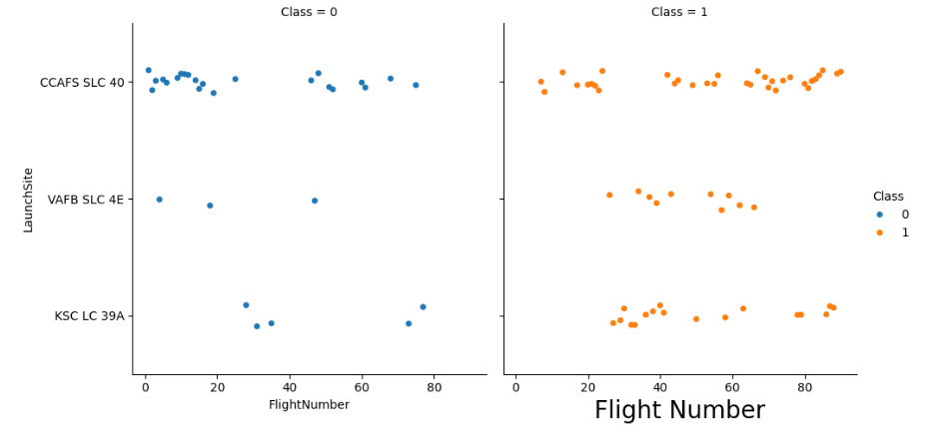
Results
Exploratory data analysis results
TASK 1: Visualize the relationship between Flight Number and Launch Site

Slide 29
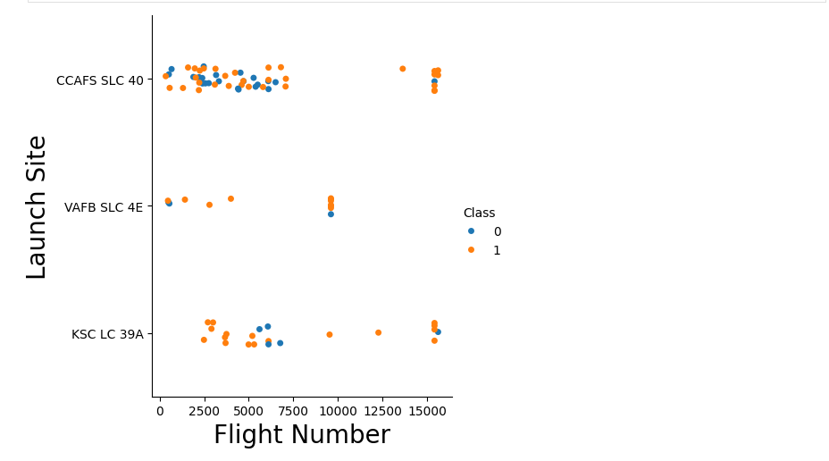
Results
Exploratory data analysis results
TASK 2: Visualize the relationship between Payload and Launch Sit

Slide 30
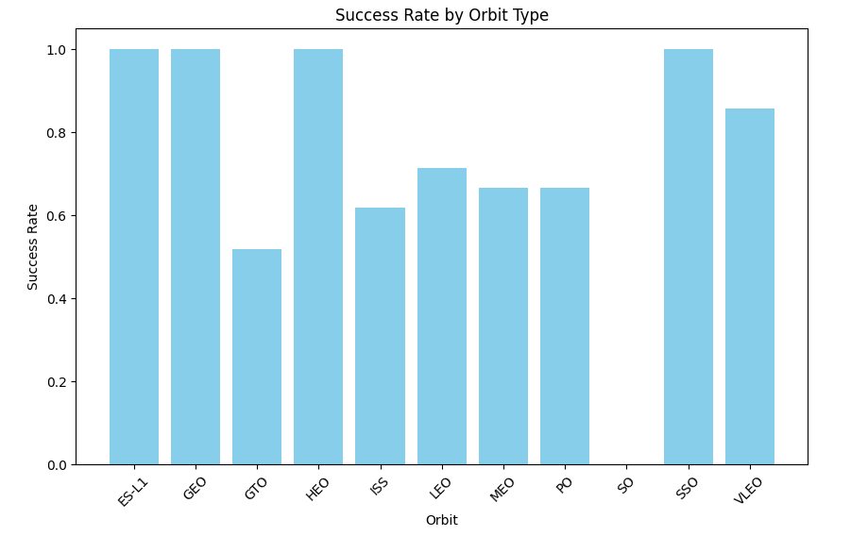
Results
Exploratory data analysis results
TASK 3: Visualize the relationship between success rate of each orbit type

Slide 31
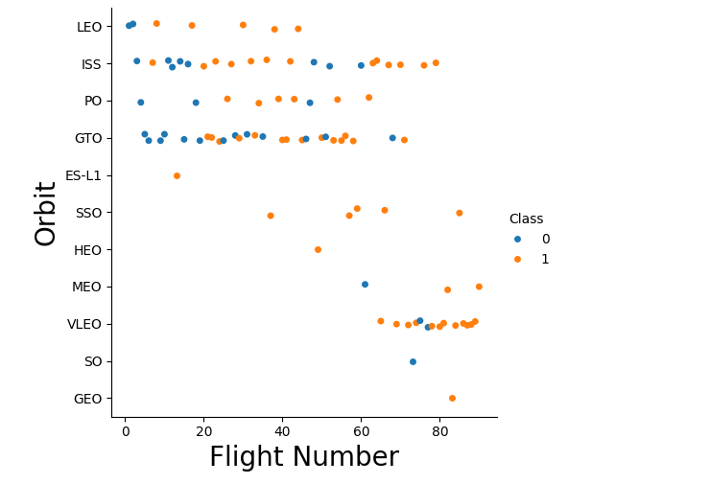
Results
Exploratory data analysis results
TASK 4: Visualize the relationship between FlightNumber and Orbit type

Slide 32
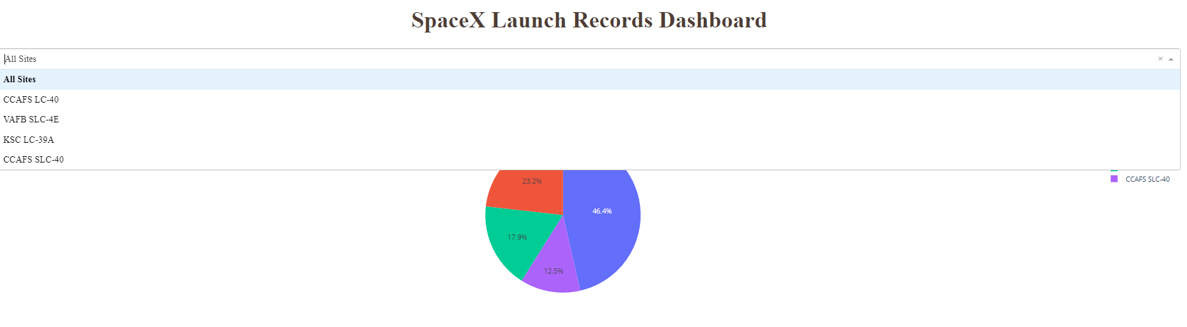
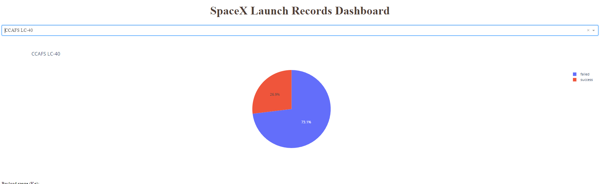
Results
Interactive analytics demo in screenshots

Slide 33
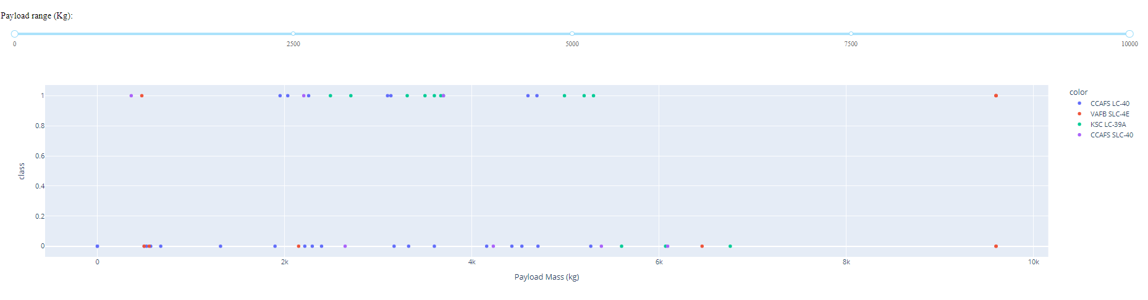
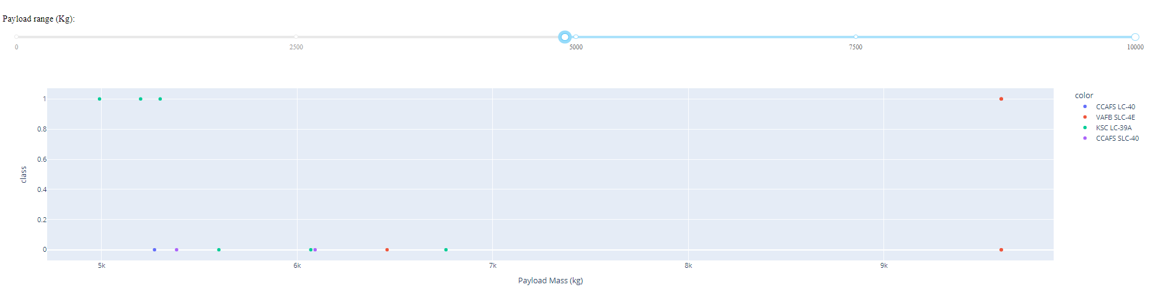
Results
Interactive analytics demo in screenshots

Slide 34
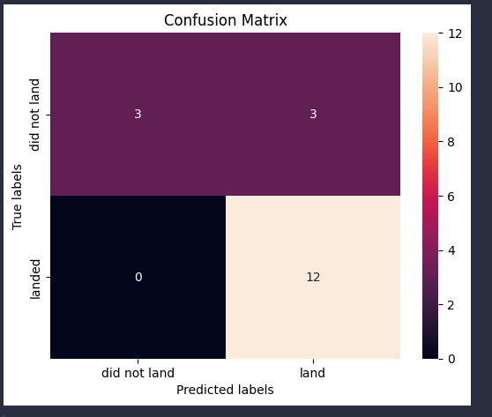
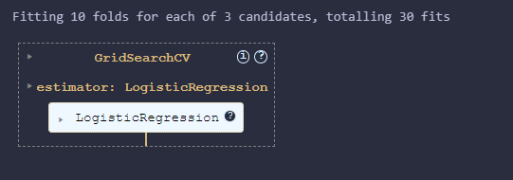
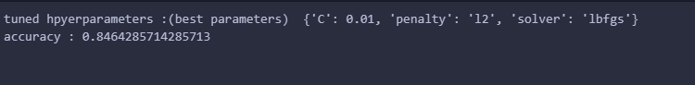
Results
Predictive analysis results
Logistic Regression

Slide 35
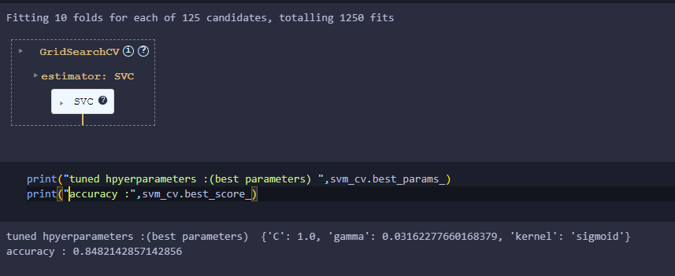
Results
Predictive analysis results
SVC

Slide 36

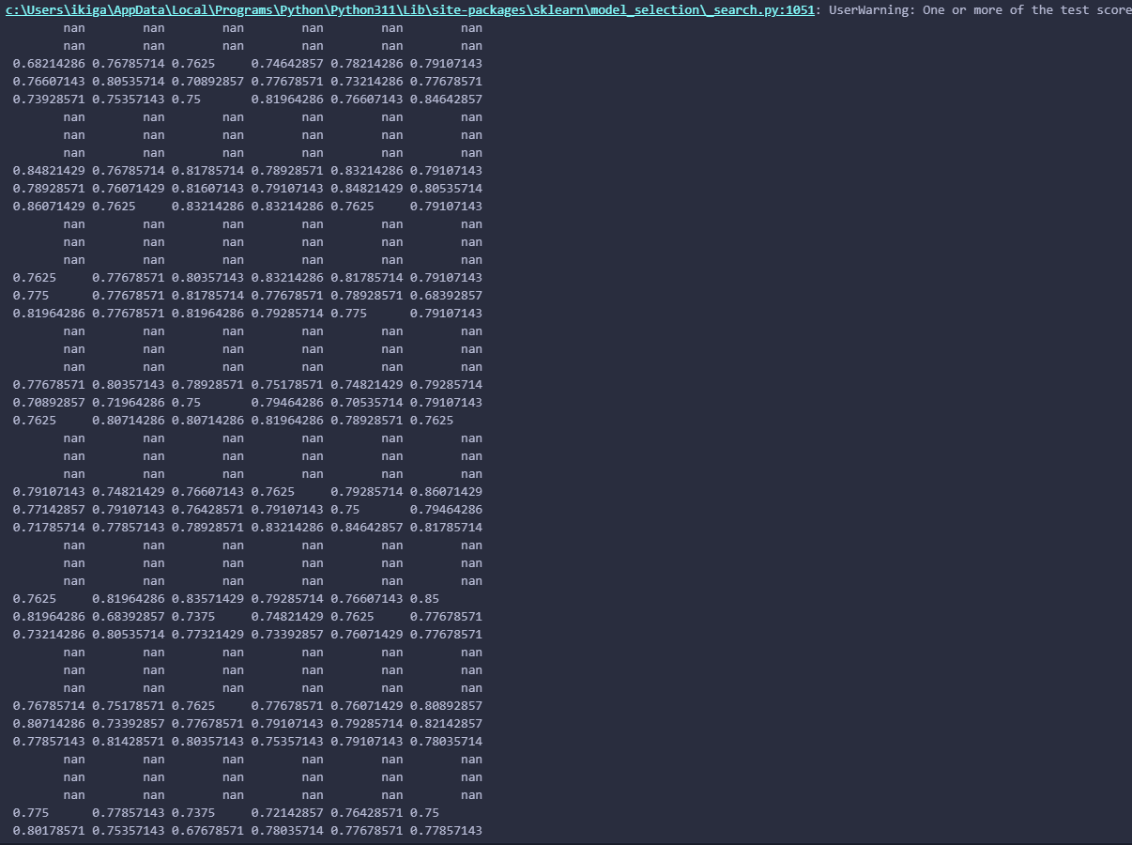
Results
Predictive analysis results
Decision Tree

Slide 37
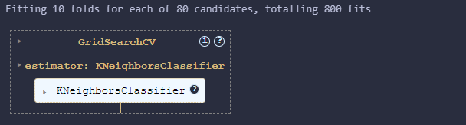
Results
Predictive analysis results
K-Neighbors

Slide 38
Results
Predictive analysis results
Finding the method performs best:

Slide 39

Section 2

Slide 40
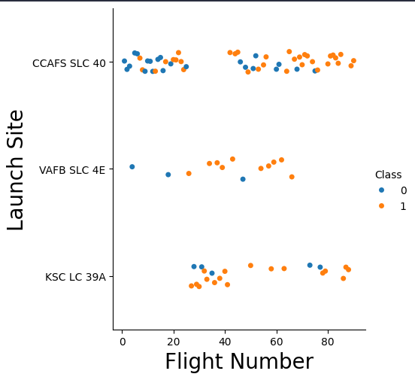
Flight Number vs. Launch Site
Show a scatter plot of Flight Number vs. Launch Site
We can see that Launch Site in Y axis and Flight Number in x-axis which in comparison the class = 1 are many compare to class = 0 in Launch site that CCAPS SLC 40 has many class on it

Slide 41
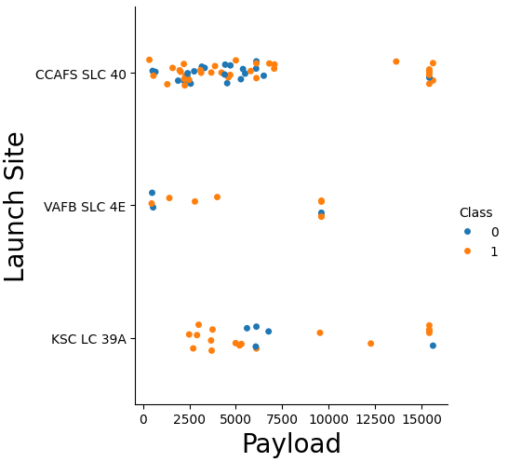
Flight Number vs. Launch Site
Show a scatter plot of Payload vs. Launch Site
We can see that Launch Site in Y axis and Payload in x-axis which in comparison the class = 1 are many compare to class = 0 and in Launch site that CCAPS SLC 40 has many class on it

Slide 42
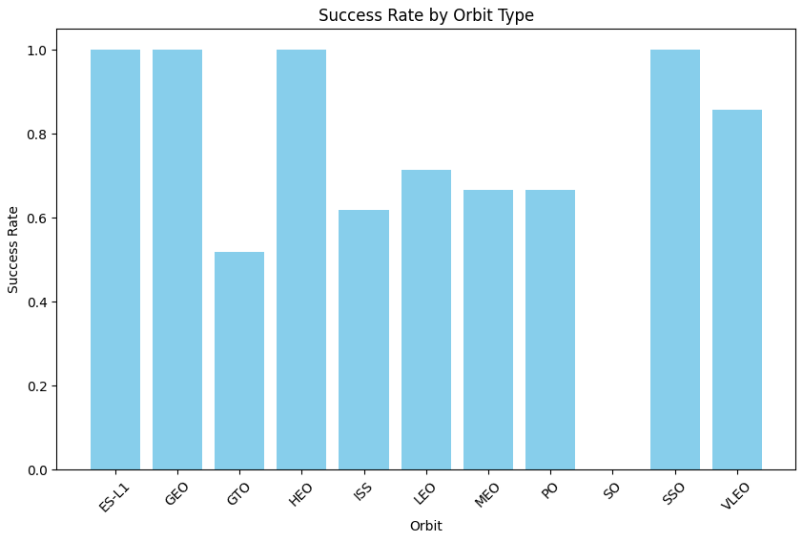
Flight Number vs. Launch Site
Show a bar chart for the success rate of each orbit type
In this chart, the success rate of ES-L1, GEO, HEO, and SSO are within the same count of Success Rate

Slide 43
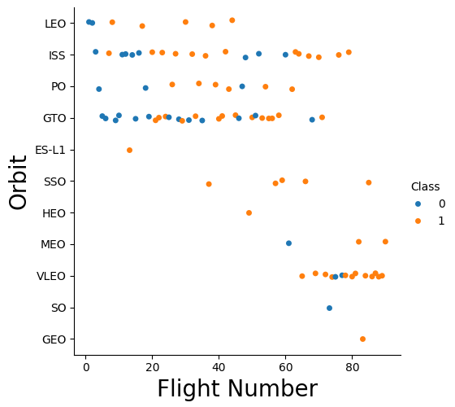
Flight Number vs. Launch Site
Show a scatter point of Flight number vs. Orbit type
As we can see the scatter point on which the VLEO has many on the estimate 60 – 80 while IISS is leading on the count following by GTO.

Slide 44
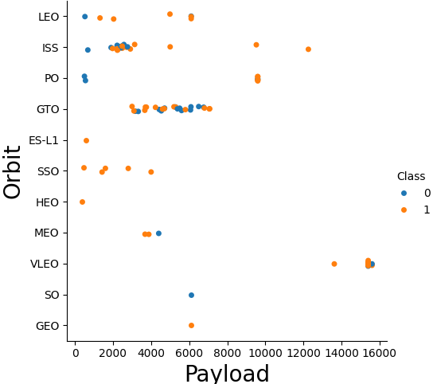
Flight Number vs. Launch Site
Show a scatter point of payload vs. orbit type
On the scatter point the GTO are intact between 2000 to not more than 800 which they compress in each other, VLEO has the highest Payload

Slide 45
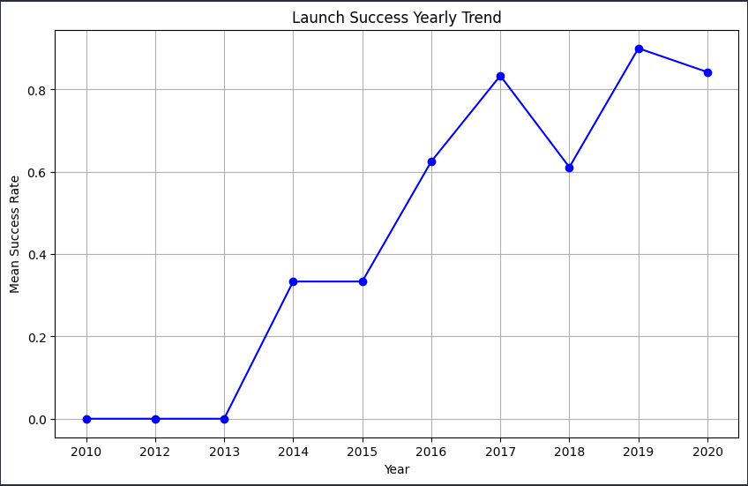
Flight Number vs. Launch Site
Show a line chart of yearly average success rate
As we can see in line chart as the yearly progress each year the launch success is increase until in 2017 which decrease a bit and in 2019 the highest of all count success rate

Slide 46
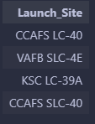
All Launch Site Names
Find the names of the unique launch sites
Query: SELECT DISTINCT Launch_Site FROM SPACEXTABLE
Output:
Explanation: Retrieves a unique list of all launch sites from the SPACEXTABLE. The DISTINCT keyword ensures that only distinct (unique) launch sites are returned, removing any duplicates.

Slide 47
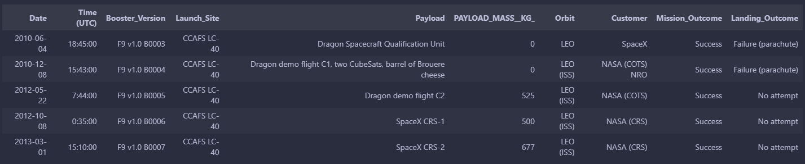
Launch Site Names Begin with 'CCA'
Find 5 records where launch sites begin with `CCA`
Query: SELECT * FROM SPACEXTABLE WHERE Launch_Site Like 'CCA%' LIMIT 5
Output:
Explanation: Retrieve all columns from SPACEXTABLE where the Launch_Site starts with 'CCA'. The LIKE 'CCA%' clause filters the results, and LIMIT 5 restricts the output to the first 5 matching records.

Slide 48

Total Payload Mass
Calculate the total payload carried by boosters from NASA
Query: SELECT SUM(PAYLOAD_MASS__KG_) as Total_payload_mass_kg FROM SPACEXTABLE WHERE customer = 'NASA (CRS)’
Output:
Explanation: Calculates the total payload mass in kilograms for all launches where the customer is 'NASA (CRS)'. The SUM(PAYLOAD_MASS__KG_) function adds up the payload masses, and the result is labeled as Total_payload_mass_kg.

Slide 49
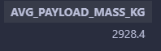
Average Payload Mass by F9 v1.1
Calculate the average payload mass carried by booster version F9 v1.1
Query: SELECT AVG(PAYLOAD_MASS__KG_) as AVG_PAYLOAD_MASS_KG FROM SPACEXTABLE WHERE Booster_Version = 'F9 v1.1’
Output:
Explanation: Calculates the average payload mass in kilograms for all launches that used the 'F9 v1.1' booster version. The AVG(PAYLOAD_MASS__KG_) function computes the average, and the result is labeled as AVG_PAYLOAD_MASS_KG..

Slide 50
First Successful Ground Landing Date
Find the dates of the first successful landing outcome on ground pad
Query: SELECT * FROM SPACEXTABLE ORDER BY Date asc limit 1
Output:
Explanation:Retrieves the earliest launch record from SPACEXTABLE. The ORDER BY Date ASC clause sorts the records by date in ascending order, and LIMIT 1 ensures only the first (earliest) record is returned.

Slide 51
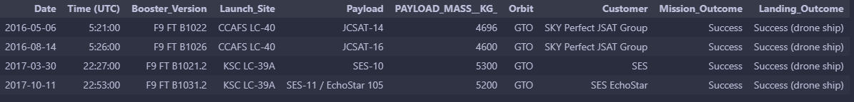
Successful Drone Ship Landing with Payload between 4000 and 6000
List the names of boosters which have successfully landed on drone ship and had payload mass greater than 4000 but less than 6000
Query: SELECT * FROM SPACEXTABLE WHERE Landing_Outcome = 'Success (drone ship)' AND PAYLOAD_MASS__KG_ >= 4000 AND PAYLOAD_MASS__KG_ < 6000
Output:
Explanation: Retrieve all columns from SPACEXTABLE where the landing outcome was a successful drone ship landing and the payload mass is between 4000 and 5999 kilograms (inclusive of 4000 but exclusive of 6000).

Slide 52
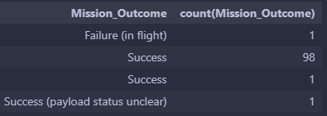
Total Number of Successful and Failure Mission Outcomes
Calculate the total number of successful and failure mission outcomes
Query: SELECT Mission_Outcome, count(Mission_Outcome) FROM SPACEXTABLE Group By Mission_Outcome
Output:
Explanation: Counts the number of occurrences of each mission outcome in SPACEXTABLE. The GROUP BY Mission_Outcome clause groups the records by the Mission_Outcome field, and the COUNT(Mission_Outcome) function provides the count for each group..

Slide 53
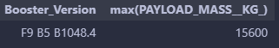
Boosters Carried Maximum Payload
List the names of the booster which have carried the maximum payload mass
Query: SELECT * FROM (SELECT Booster_Version, max(PAYLOAD_MASS__KG_) FROM SPACEXTABLE)
Output:
Explanation: Retrieve all columns from the result of a subquery that finds the maximum payload mass for each booster version in SPACEXTABLE. The MAX(PAYLOAD_MASS__KG_) function identifies the highest payload mass

Slide 54
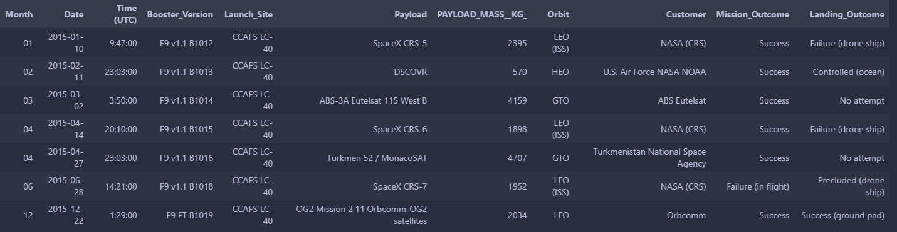
2015 Launch Records
List the failed landing_outcomes in drone ship, their booster versions, and launch site names for in year 2015
Query: SELECT substr(Date, 6,2) as Month, * FROM SPACEXTABLE WHERE substr(Date, 0,5) = '2015'
Output:
Explanation: Retrieve all columns from SPACEXTABLE along with the month extracted from the Date column for records from the year 2015. The SUBSTR(Date, 6, 2) function extracts the month part of the date, and SUBSTR(Date, 1, 4) = '2015' filters the results to include only those from the year 2015

Slide 55
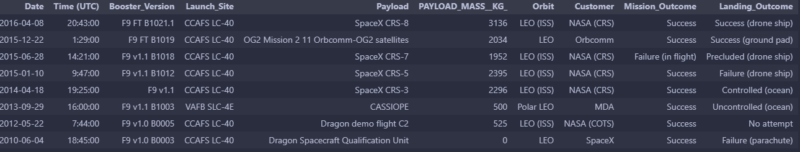
Rank Landing Outcomes Between 2010-06-04 and 2017-03-20
Rank the count of landing outcomes (such as Failure (drone ship) or Success (ground pad)) between the date 2010-06-04 and 2017-03-20, in descending order
Query: SELECT * FROM (SELECT * FROM SPACEXTABLE WHERE DATE(date) BETWEEN '2010-06-04' AND '2017-03-20') GROUP BY Landing_Outcome ORDER BY date DESC
Output:
Explanation: Retrieve all records from SPACEXTABLE where the date falls between June 4, 2010, and March 20, 2017. It then groups the results by Landing_Outcome and sorts the grouped results by date in descending order.

Slide 56

Section 3

Slide 57
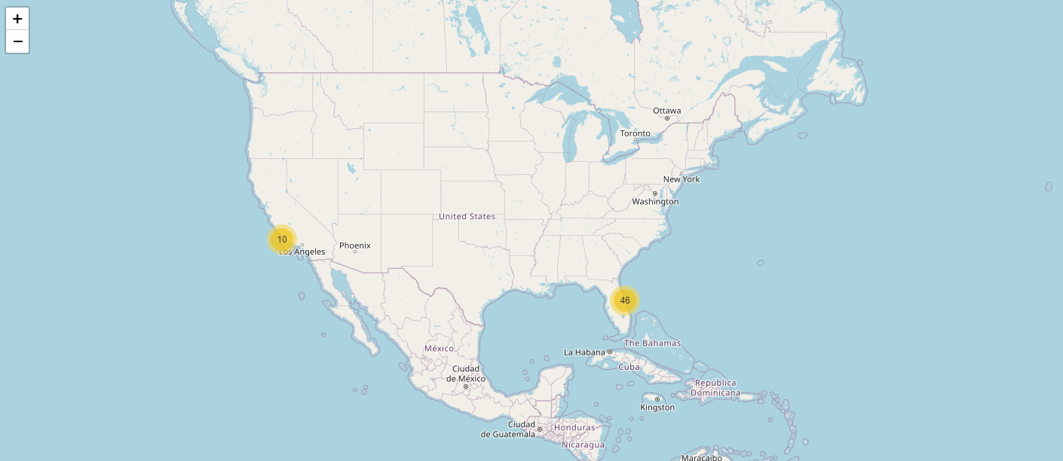
Locations of Launching Area for SpaceX
Explore the generated folium map and make a proper screenshot to include all launch sites’ location markers on a global map
The only location for SpaceX Launch exist in West Coast located in State of California and for the East Code is onMiami State

Slide 58
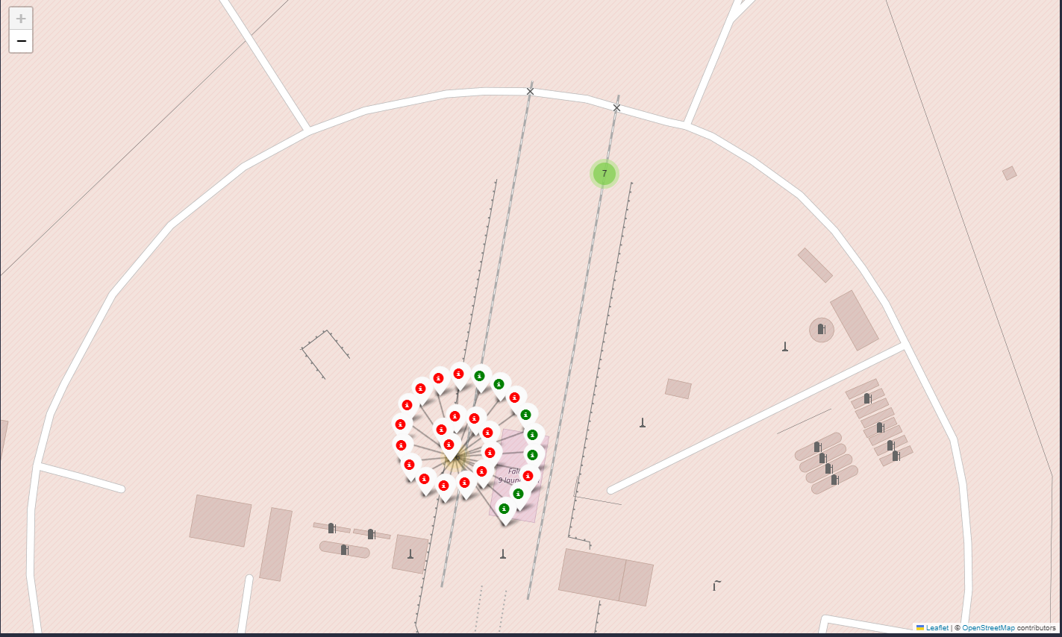
Color Differentiation in Assessing Launch Outcomes
Explore the folium map and make a proper screenshot to show the color-labeled launch outcomes on the map
As per example in which located in Falcon 9 launchpad only 7 launch is success and other color is failed

Slide 59
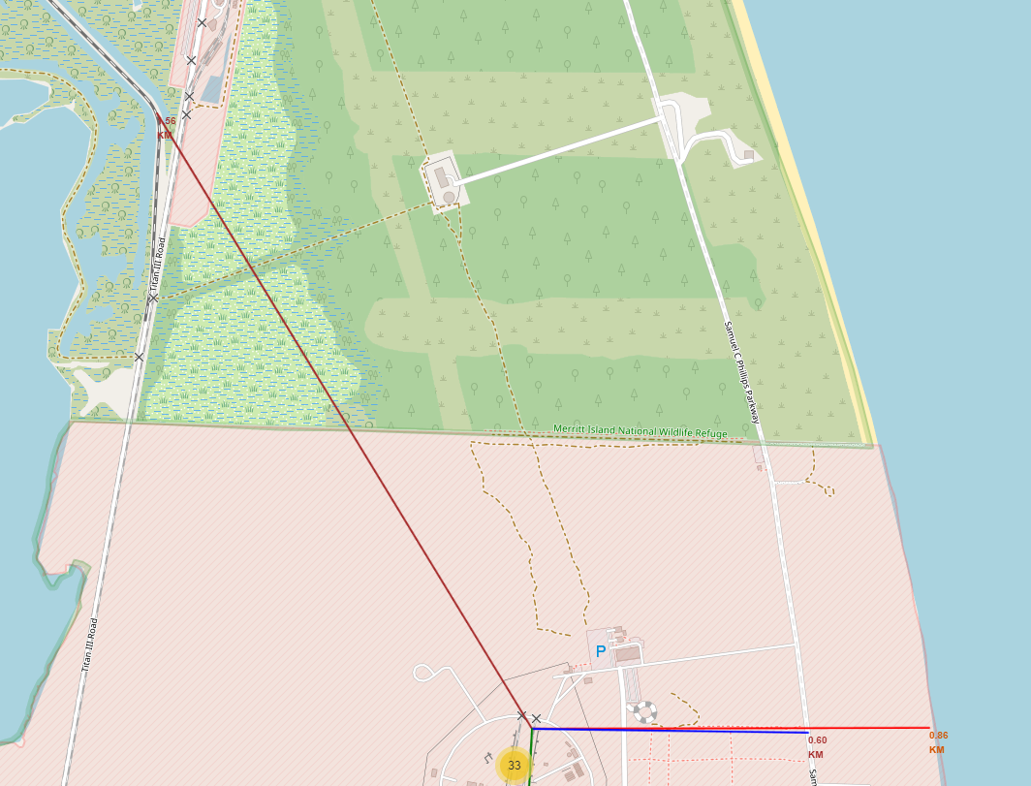
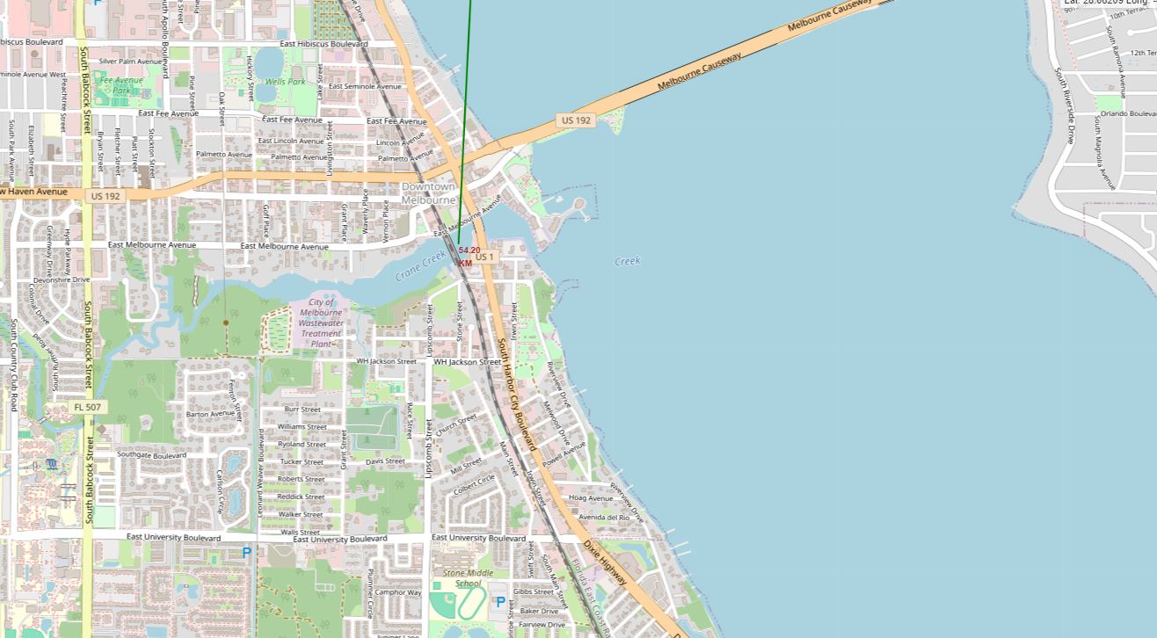
Locating and Calculate distance between a launch site and its proximities
Explore the generated folium map and show the screenshot of a selected launch site to its proximities such as railway, highway, coastline, with distance calculated and displayed
The Distance calculated from a launch site to city of Melbourne is 54.20 KM while the distance from site to road is 0.60 KM, to coast line 0.86KM, and to the railroad is 1.56 KM

Slide 60

Section 4

Slide 61
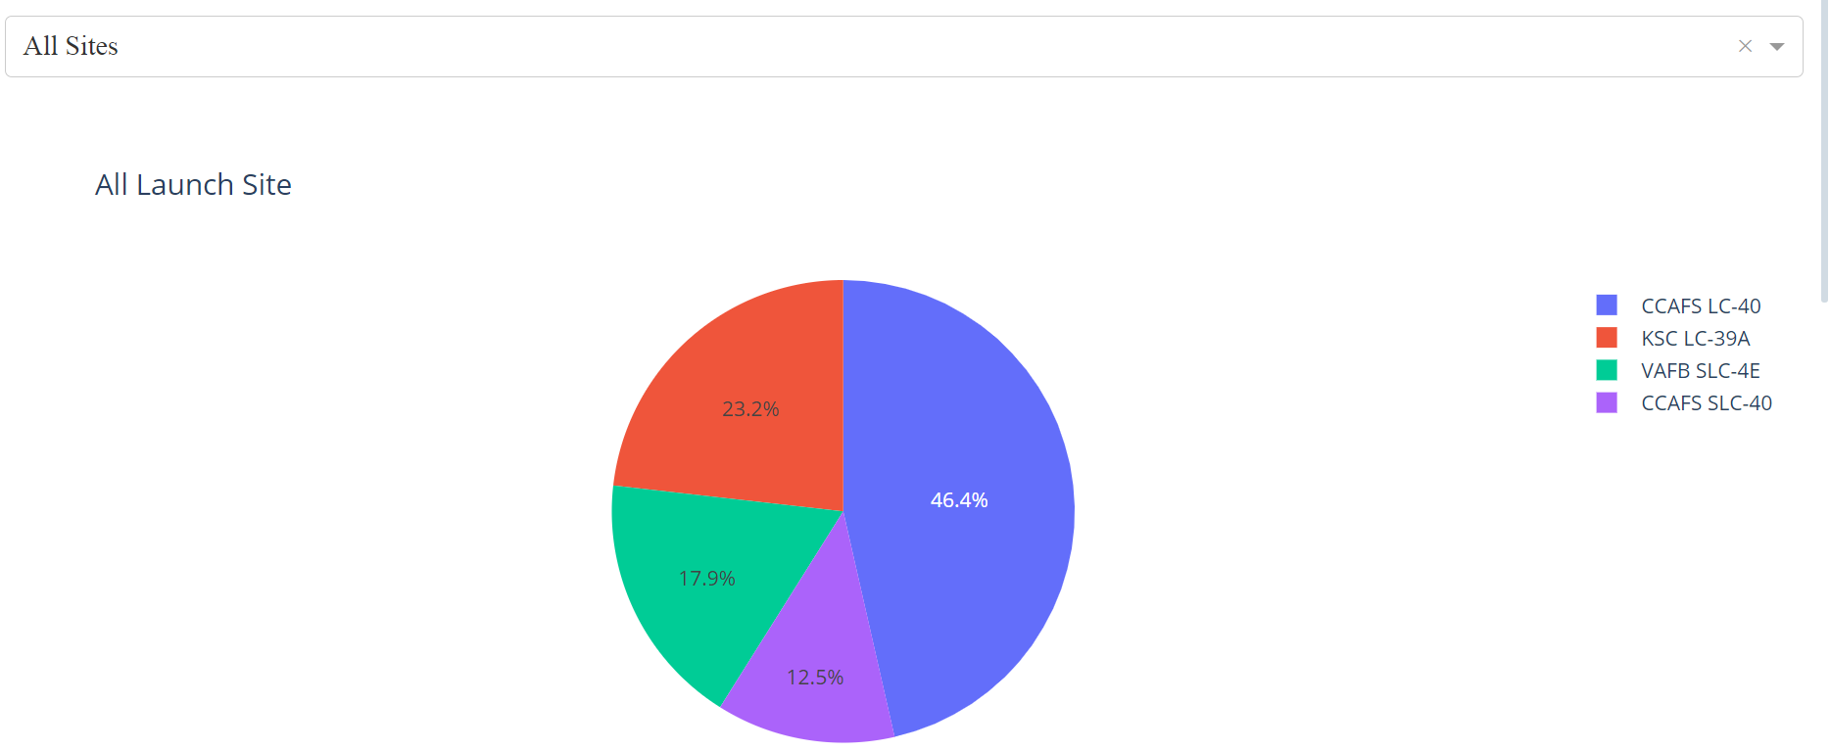
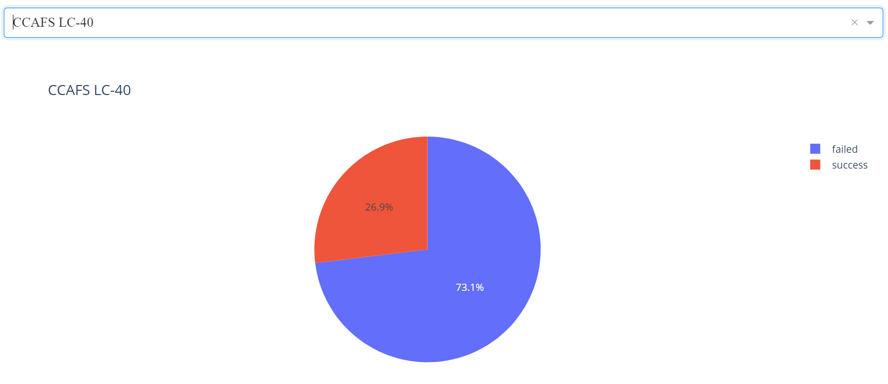
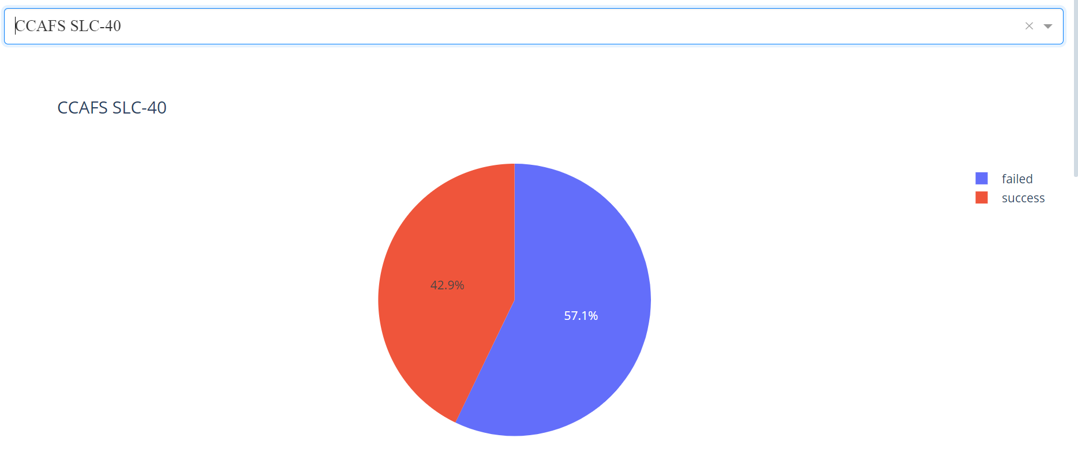

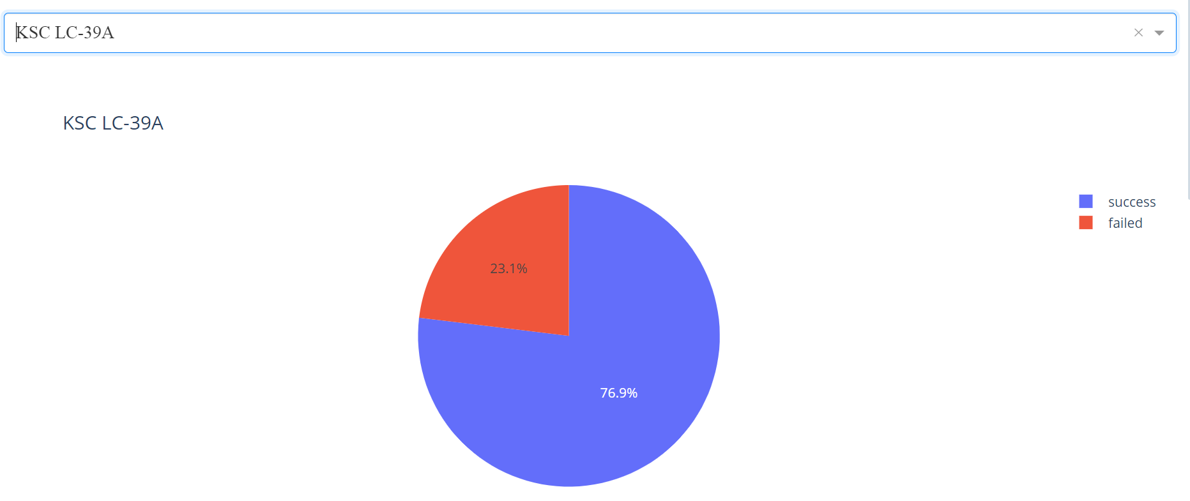
Pie chart of Launch Site Success Rate
Show the screenshot of launch success count for all sites, in a piechart
The Highest ratio of success in these Pie chart is CCAFS SLC where the lowest is
KSC LC -39A

Slide 62
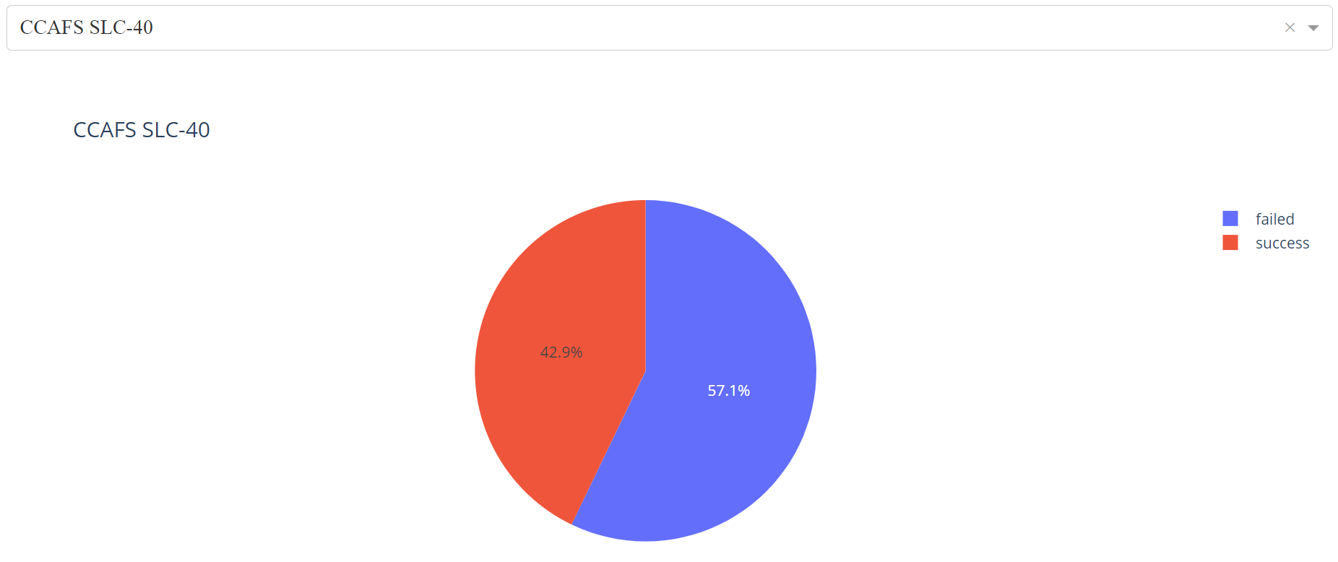
Highest Success Rate Launch in Pie Chart
Show the screenshot of the piechart for the launch site with highest launch success ratio
The Success Rate of this site is 42.9% or has 3 success launch and then has the failed count of 4

Slide 63
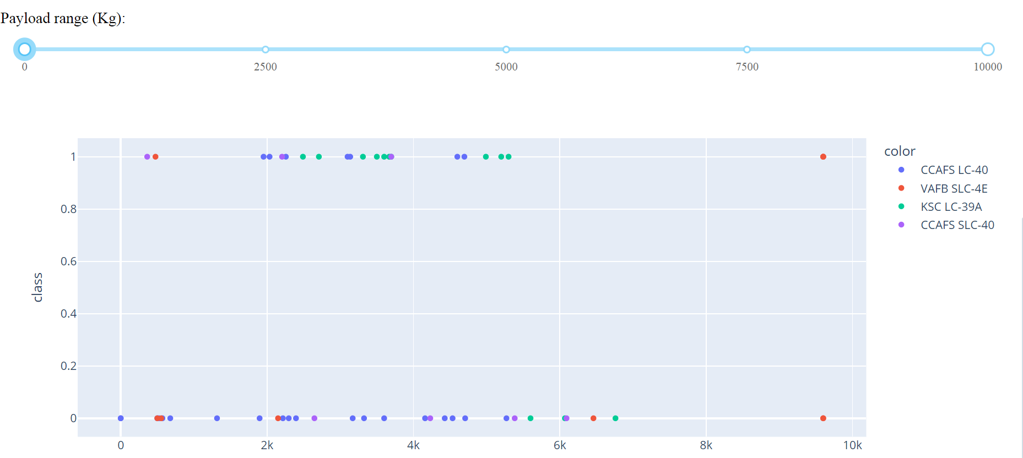
Scatter Plot of Payload Range
Show screenshots of Payload vs. Launch Outcome scatter plot for all sites, with different payload selected in the range slider
As we can see in the scatter plot CCAFS LC-40 (Blue): Consistent presence across the entire payload range, VAFB SLC-4E (Red): Appears mostly in lower payload ranges (up to about 3,500 Kg), with a couple of points near the highest payload range (around 10,000 Kg). KSC LC-39A (Green): Appears across a broad range of payloads, mostly in Class 1. CCAFS SLC-40 (Purple): Similar to CCAFS LC-40, present across the payload range.

Slide 64

Section 5

Slide 65
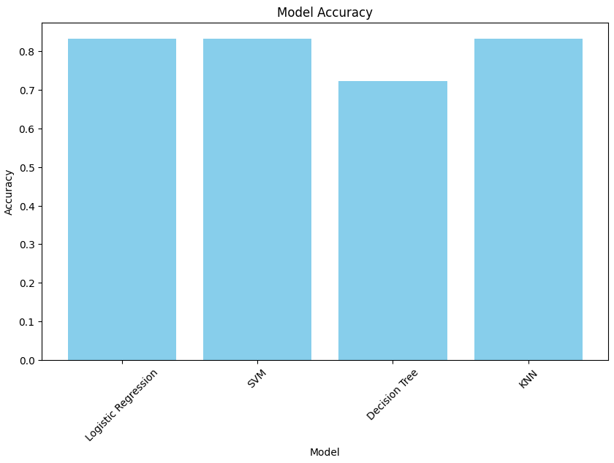
Classification Accuracy
Visualize the built model accuracy for all built classification models, in a bar chart
The model Logistic Regression, Decision Tree and KNN are the same value with
0.8333333333333334

Slide 66
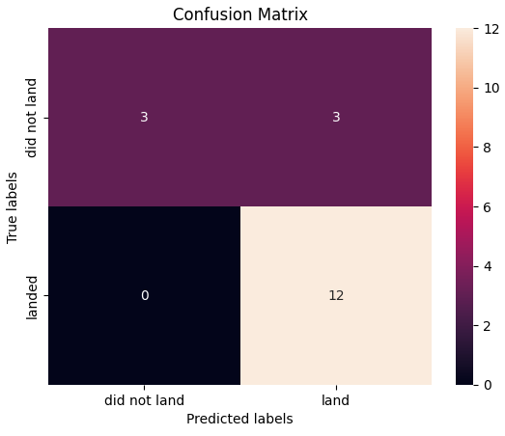
Confusion Matrix
Show the confusion matrix of the best performing model with an explanation
Examining the confusion matrix, we see that logistic regression can distinguish between the different classes. We see that the major problem is false positives.

Slide 67
Conclusions
Overview of Models Tested:
Logistic Regression
Support Vector Machine (SVM)
Decision Tree
K-Nearest Neighbors (KNN)
Performance Summary:
Logistic Regression: Accuracy = 0.8333
SVM: Accuracy = 0.8333
Decision Tree: Accuracy = 0.7222
KNN: Accuracy = 0.8333
Best Performing Model::
Model: Logistic Regression
Accuracy: 0.8333
Key Findings:
Logistic Regression, SVM, and KNN all achieved the same highest accuracy of 0.8333, indicating strong performance.
The Decision Tree model performed slightly lower with an accuracy of 0.7222
Implications:
Logistic Regression, with its high accuracy, is recommended for predicting Falcon 9 first stage landing success
Additional considerations may include model complexity, interpretability, and computational efficiency when selecting the final model.

Slide 68
Appendix
Python Code Libraries:
import pandas as pd
import numpy as np
import matplotlib.pyplot as plt
import seaborn as sns
from sklearn import preprocessing
from sklearn.model_selection import train_test_split
from sklearn.model_selection import GridSearchCV
from sklearn.linear_model import LogisticRegression
from sklearn.svm import SVC
from sklearn.tree import DecisionTreeClassifier
from sklearn.neighbors import KNeighborsClassifieri
import requestsSQL

Slide 69
Appendix
SQL Queries:
SQLite
Data Gathering:
SpaceXAPI
Wikipedia Page for SpaceX
Relevant Assets:
Python code snippets
SQL queries
Charts
Notebook outputs
Data sets created during the project

Slide 70


